Slide 1
Welcome
Project information

Slide 2
Title
Title : Super Marketing Management System
System : Web Application
Project Creators : Aaryan Mangukiya,
Ronit Korat,
Shivam Dholeriya,
Divyam Gabani.
Institution : Shree Ramkrishna Institute of Computer Education And Applied Sciences
Date : 06 September 2024

Slide 3

Project definition
A Supermarket Billing System is a software application designed to automate the process of generating bills for purchases made in a supermarket. It records item details, calculates the total cost, applies discounts, and generates invoices.

Slide 4

Project objective
The objective of a Supermarket Billing System is to streamline and automate the billing process, ensuring quick, accurate, and reducing manual errors, and improving overall customer service.

Slide 5
Project information
Home Page
Create Account
SUPER MARKET
About Us
Login Page
Contact Us

Slide 6
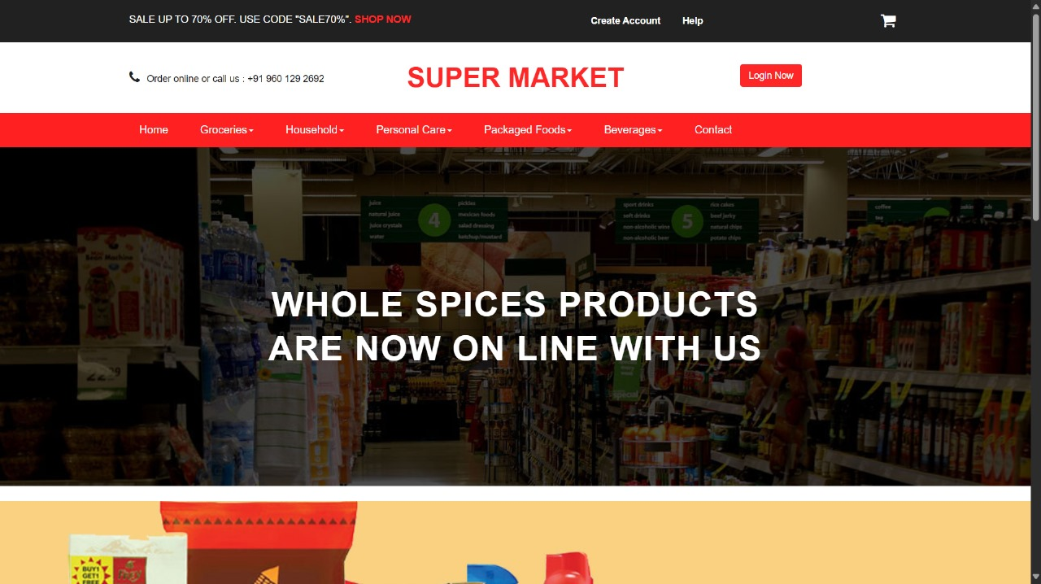
Home page
home

Slide 7
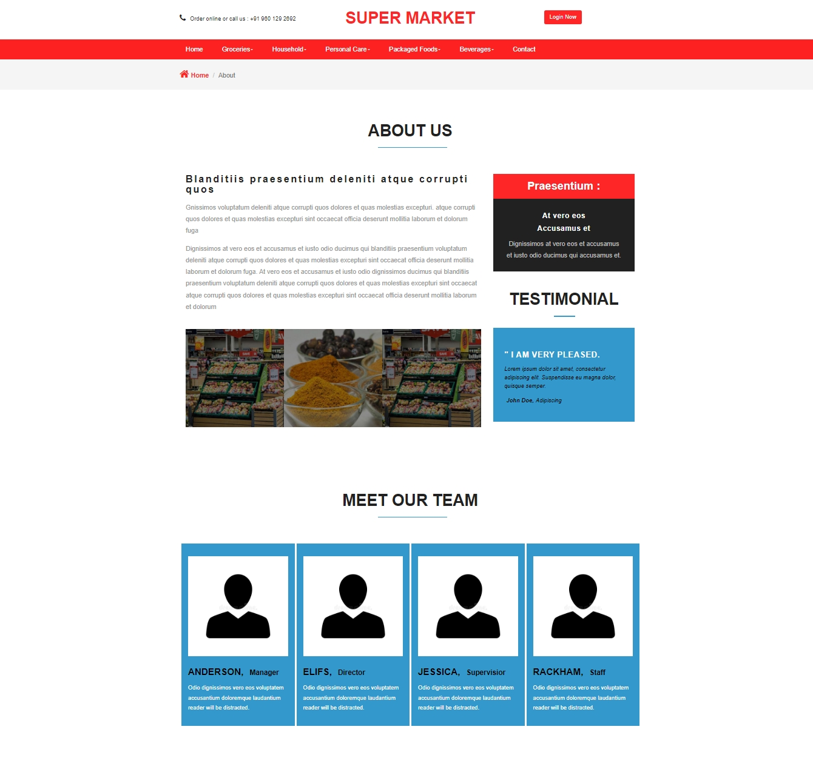
About us

Slide 8
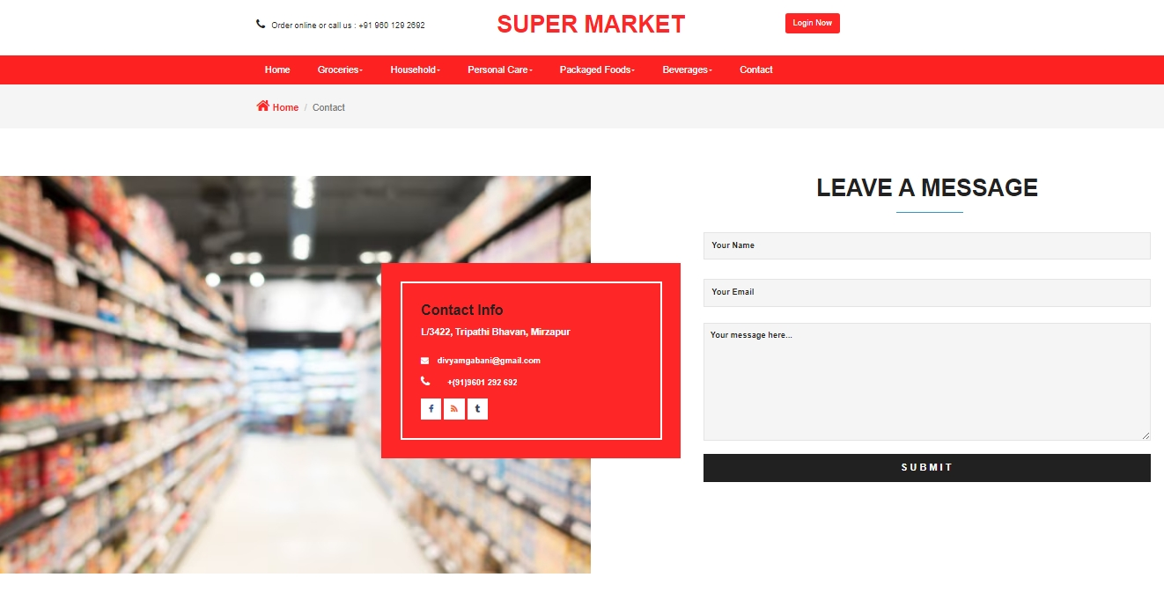
Contact Us

Slide 9
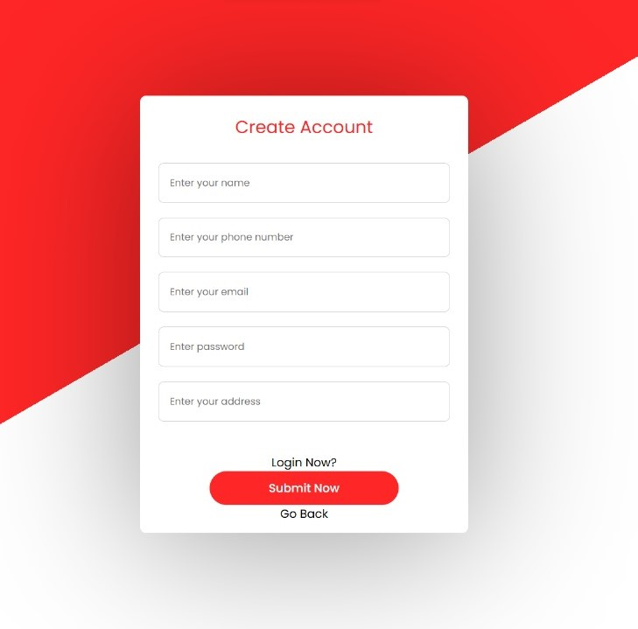
Create Account
Create Account Detail :
Your Name
Your Phone Number
Your Email
Your Password
Your Address

Slide 10
Login information
Login
Admin
Seller
Dashboard
Category
Product
Seller
Allbills
Billing
BillHistory
Logout

Slide 11
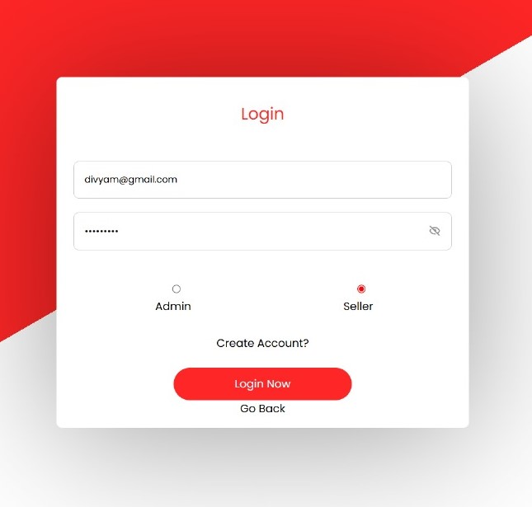
Login page
Login
Two Type :
Admin
seller

Slide 12
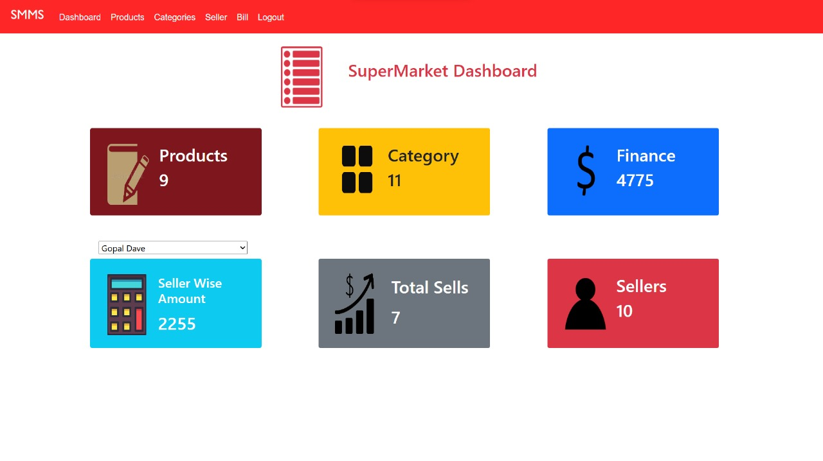
Admin : Dashboard
In the dashboard page, we can get information about how many products, how many categories, how much money has come, how many sales, how many sellers and how many items the seller has sold from the statistics.

Slide 13
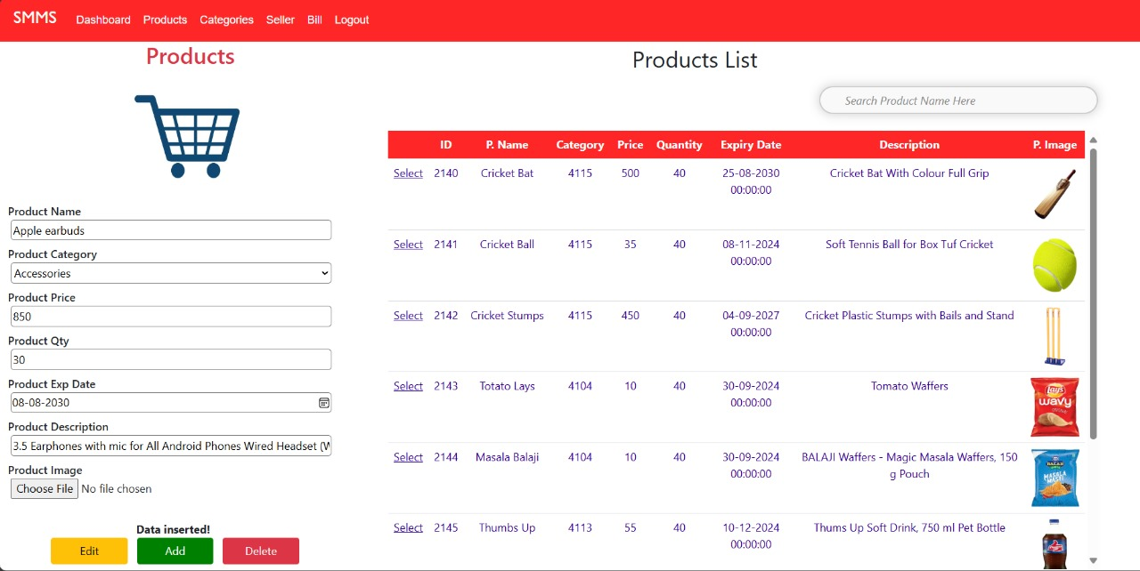
Admin : Products
The product page also contains the product name, category, price, content, description and image, in which you can add, change and delete products, and you can search for products with different names by the search operation from the product name.

Slide 14
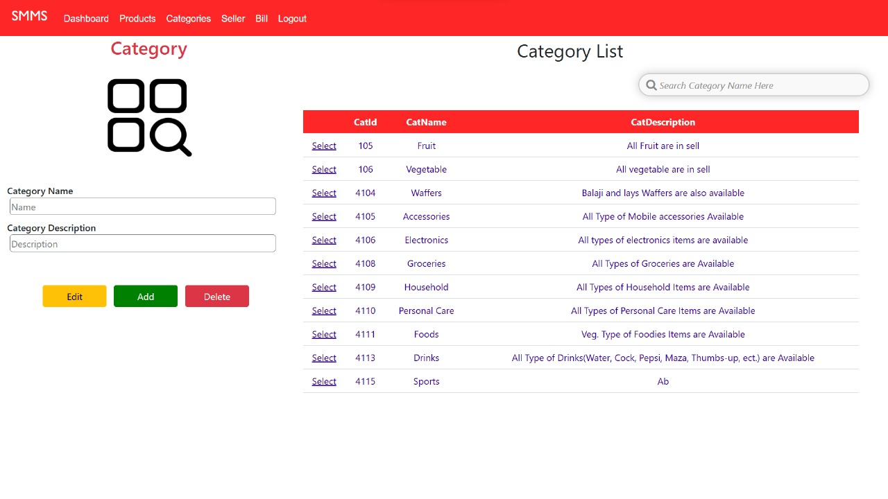
Admin : Categories
Category page has category unique ID, category name, and category description, in which you can add product description with different names, change or delete it, you can search and find your category by category name.

Slide 15
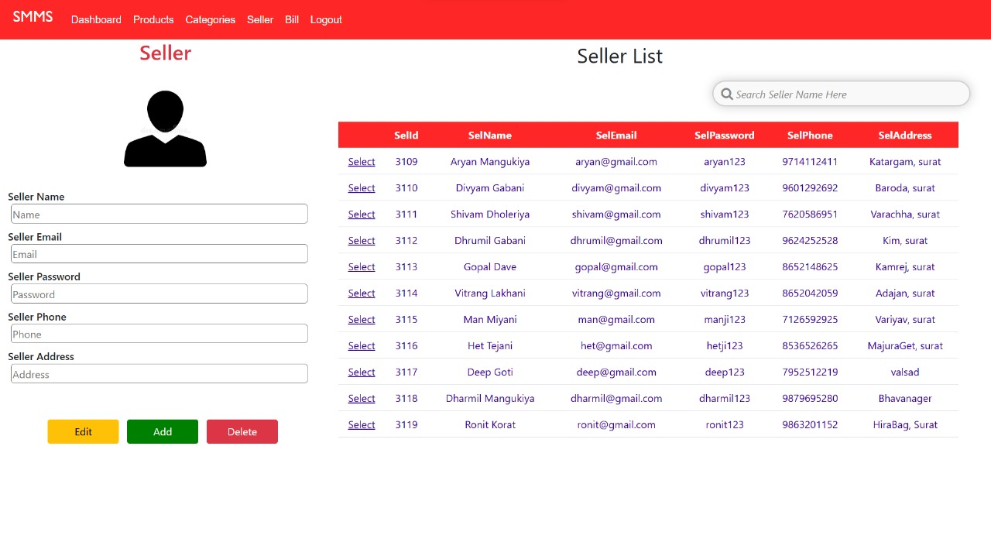
Admin : seller
You can add different sellers in the seller page with name, email, password, phone number and address. You can also change or delete it. You can also login by email and password. Can also perform search operation by seller name.

Slide 16
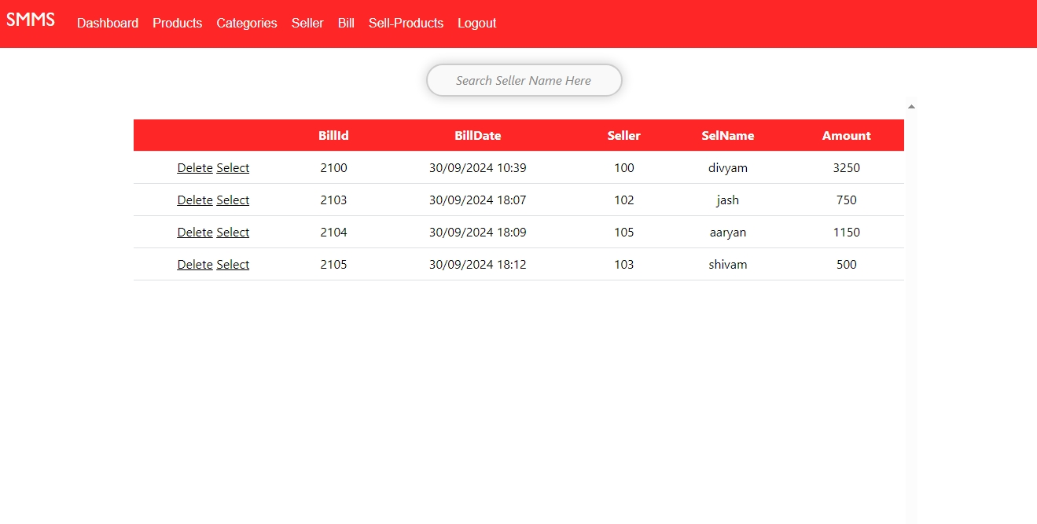
Admin page : Bill
The All Bills page contains bills for every item sold Which is sold by the seller. Can also delete its bills which is with the admin.

Slide 17
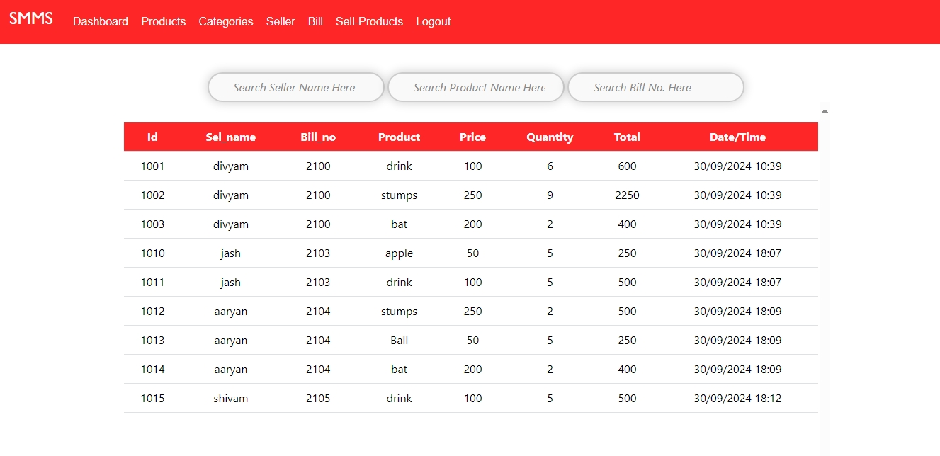
Admin page : Sell - Products

Slide 18
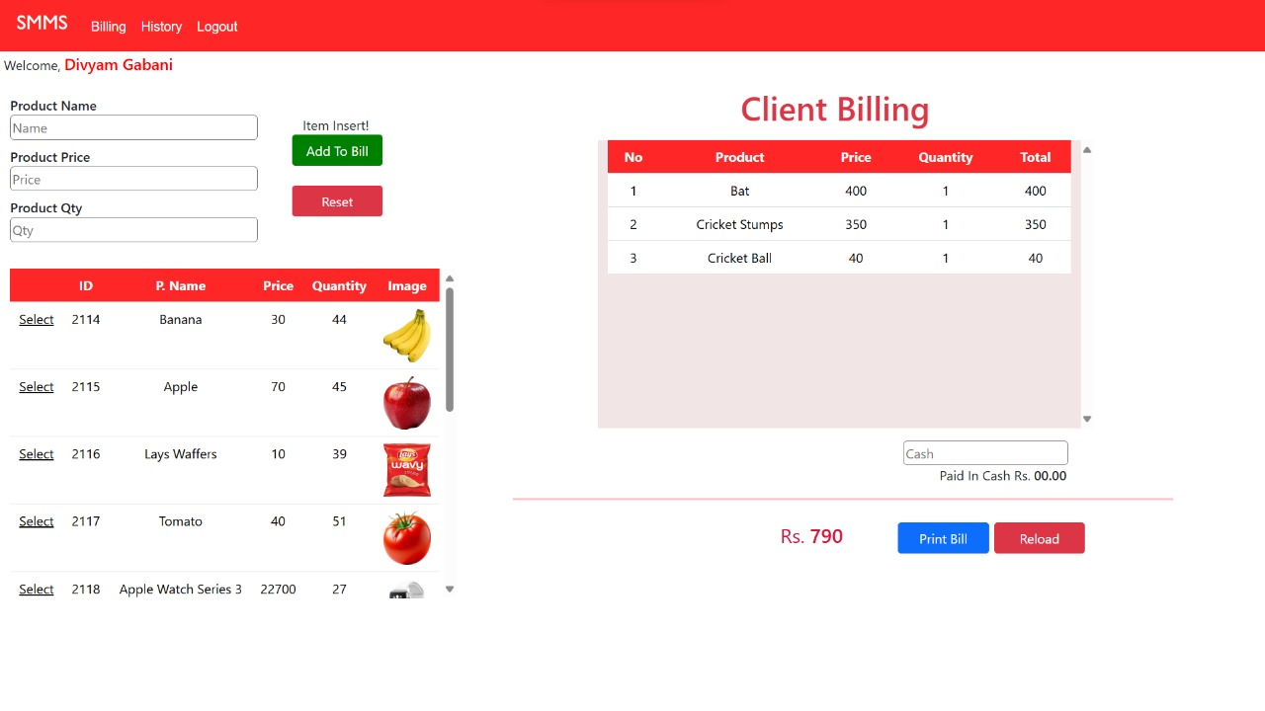
Seller : Billing
The bill page contains all the products that are provided from the admin side. As much as the bill is stored in a temporary table. The price of each item billed to A is shown below in a total price. Print Bell generates a PDF format and prints it And that data is found in Bill History or All Bills page.

Slide 19
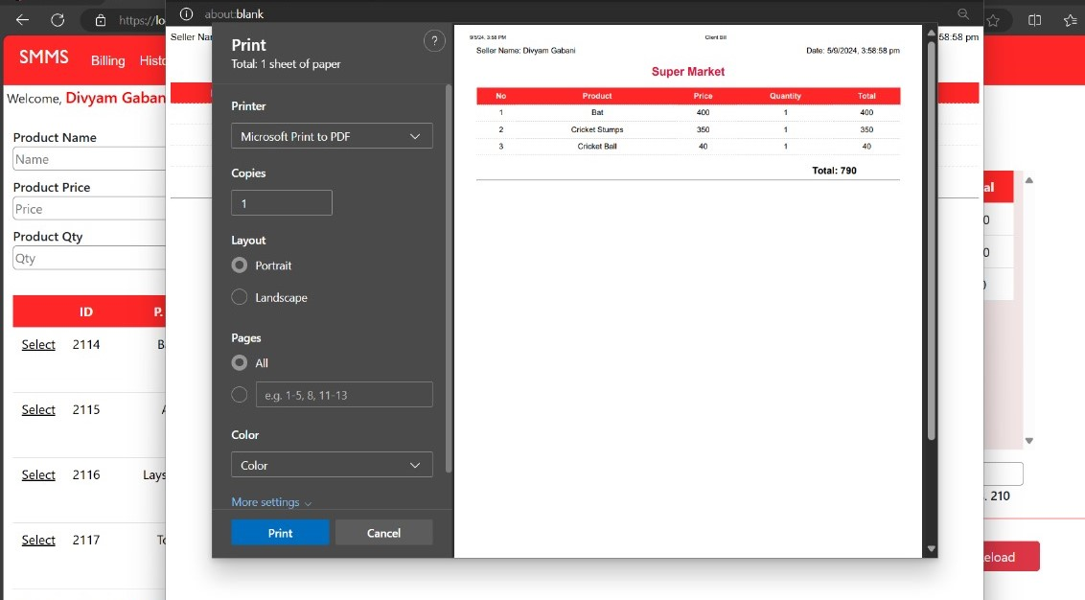
PDF bill

Slide 20
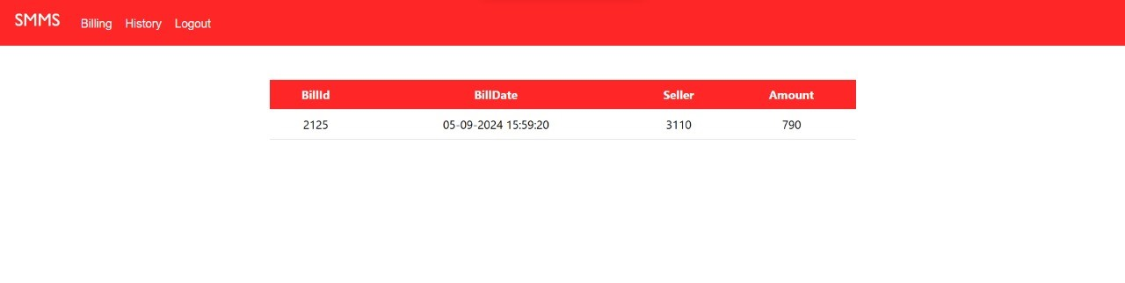
Seller : bill history
In the billing page, the details of the seller for whom the bill has been generated and the total amount of his bill can be seen on this page.

Slide 21
The end
Thank you.

